Slide 1
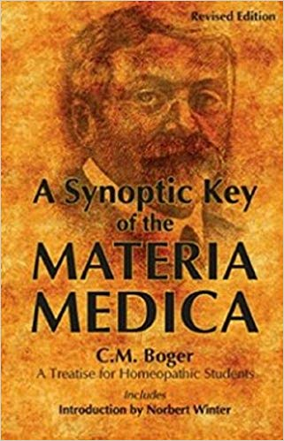
BOGER’S SYNOPTIC KEY & REPERTORY
EVOLUTION
Dr.V.SATHISH KUMAR, M.D (Hom)
HOD and Professor, Department of Repertory
Sarada Krishna Homoeopathic Medical College
Kulasekharam

Slide 2
1915 FIRST EDITION - 224 PAGES
1916 SECOND EDITION – 234 PAGES
1928 THIRD EDITION – 332 PAGES
1931 FOURTH EDITION – 350 PAGES
FIFTH EDITION - 448 PAGES
SIXTH EDITION – 460 PAGES

Slide 3
LAYOUT
Divided into three sections
Part One
Analysis (Repertory)
Part Two
Synopsis (Materia Medica)
Part Three
Supplemental Reference Table

Slide 4
PART ONE – ANALYSIS
A Short Repertory containing -
1. The Period of Aggravation
2. Conditions of Aggravation and Amelioration
Modalities
3. Generalities - The drug affinities for the
entire Organism (General sensations and
Complaints)
4. Regional Repertory
- Locations and Complaints (Particulars)

Slide 5
PART TWO – SYNOPSIS
It is an exposition of the important and characteristic features of the 323 most important remedies of the Homoeopathic Materia Medica with their physiologic-pathology, modalities and relationships etc.

Slide 6
PART THREE
Comprising of
1. Table of the Approximate Duration of
Action of Remedies
2. Complementary Remedies
3. Antagonistic Remedies
4. Supplemental Reference Table - a valuable additional table for ready reference to the Repertorial Portion in the Text

Slide 7
ANALYSIS - THE REPERTORY
1. The period of Aggravation
TIME –
Periodically
Morning
Afternoon
Evening
Night

Slide 8
2. Condition of Aggravation and Amelioration
Air
Anticipations to Yawning (In alphabetical order)
3. Generalities
Aching
Acridity
Albuminous to Yellow (In alphabetical order)

Slide 9
REGIONAL REPERTORY
Intellect
Mind
Vertigo
Head
Eyes
Vision
Ear
Hearing
Nose and
Accessory cavities
Face
Teeth
Gums
Palate
Tongue
Mouth and Throat
Saliva
Taste
Appetite
Aversions
Thirst
Craving / Desires
Water brash
Heart burn
Qualmishness
Hiccough
Nausea
Regurgitation
Retching and gagging
Vomiting
Eructation
Epigastrium
Stomach and Abdomen
Ext. Abdomen
Hypochondria
Flatulence
Groins
Anus and Rectum
Perineum
Stool
Micturition

Slide 10
Urine
Sediments
Concomitants
Urinary Organs
Genitals
Male Organs
Female Organs
Sexual impulses
Menstruation
Leucorrhoea
Concomitants
Respiration
Concomitants
Cough
Larynx and Trachea
Voice and Speech
Ext. Throat
Neck and Nape
Chest and Lungs
Ext. Chest
Axilla
Mammae
Nipple
Heart and circulation
Back, Spine and
Spinal cord
Scapula
Dorsal
Lumbar
Sacrum
Upper Extremities
Lower Extremities
Skin
Sleep
Chill
Heat
Sweat

Slide 11
SUPPLEMENTAL REFERENCE TABLE
ABDOMEN- 76. To
ZOSTER – 100. Mez.
This table has been enlarged considerably
from the previous editions, especially by
transferring most of the comparisons to it
from the text of the respective remedies. This
makes for clearness and facility of reference
Numerical after the rubric denote the page in the main repertory in which the first rubric along with its related medicines have been recorded

Slide 12
THANK YOU

